Slide 1
Playlist: OOP in C++ - Object Oriented Programming YouTube Channel: MyLegacy in Programming (Eman)
Class Relations
Composition - Aggregation - Association
Eman Hosam

Slide 2
Agenda
Logical Meaning
Class Relations: Single Variable
Class Relations: Array Variable

Slide 3
Logical Meaning
Class Relations

Slide 4
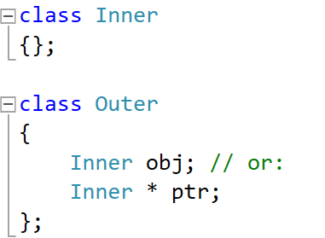
Logical Meaning of Class Relations
Composition: (has-a relationship)
When the outer class object is destructed, the inner class object must be destructed (automatic/static allocation inside the outer class)
Very Strong Relationship (Example: Car and CarBody)
Aggregation: (has-a relationship)
When the outer class object is destructed, the inner class object may be destructed (dynamic allocation inside the outer class)
Strong Relationship (Example: Car and Wheel)
Association: (uses relationship)
When the outer object is destructed, the inner class object is not affected. (no allocation inside the outer class)
Weak Relationship (Example: Car and Driver)

Slide 5
Single Variable
Class Relations

Slide 6
Order of Construction/Destruction
Order of Construction of class X:
Data members of X (in order)
Constructor of Class X itself
Order of Destruction of class X:
Destructor of Class X itself
Data members of X (reverse order)
Notes:
Pointers do NOT call constructors or destructors
Constructors are called: X x1; or new X;
Destructors are called: } or delete pX;
Note: the above order of construction or destruction is the order of body execution not calling.
Obj
Data-member1
Data-member 2

Slide 7
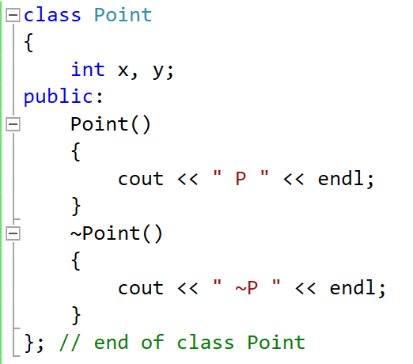
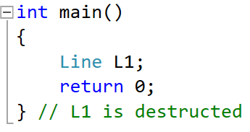
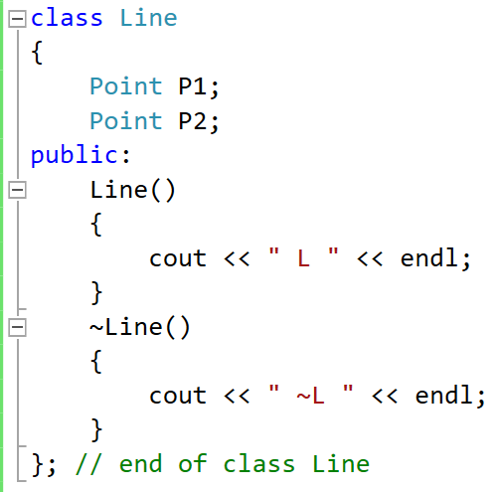
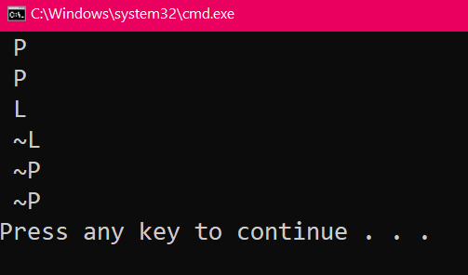
Composition
Line Obj
L1
Point Objs
3
P1
x
y
3
P2
x
y
2
4
Same for P1
2
4
Same for P2
P1 is an Object, so to call a function on it: Dot Operator
P1.func();
1
5
1

Slide 8
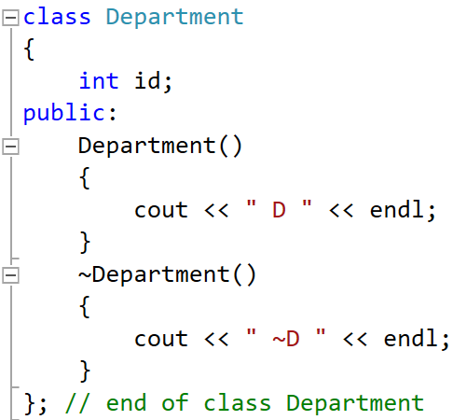
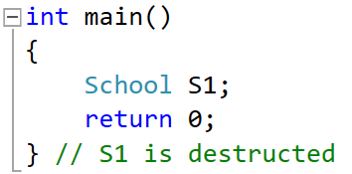
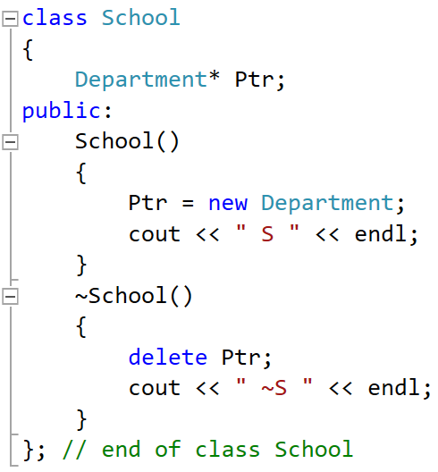
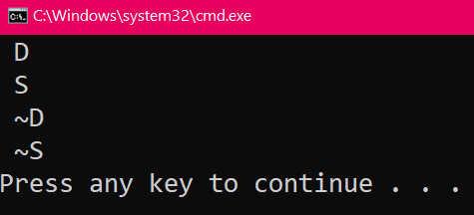
Aggregation
School Obj
4
Dep Obj
S1
Dep Ptr
2
Ptr
id
Heap
Stack
2
4
Note:
Ptr is a Pointer, so to call a function on it: Arrow Operator
P1->func();
1
Note: No constructor/destructor are called for Pointer data members by default ➔ need explicit
new and delete
3
5
1
3
5

Slide 9
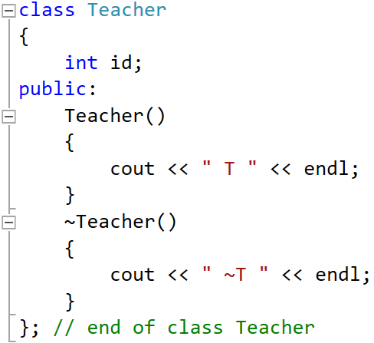
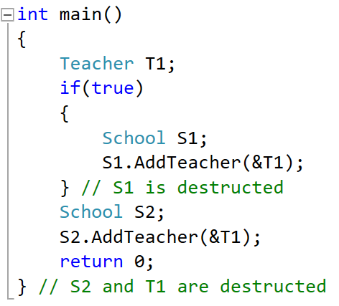
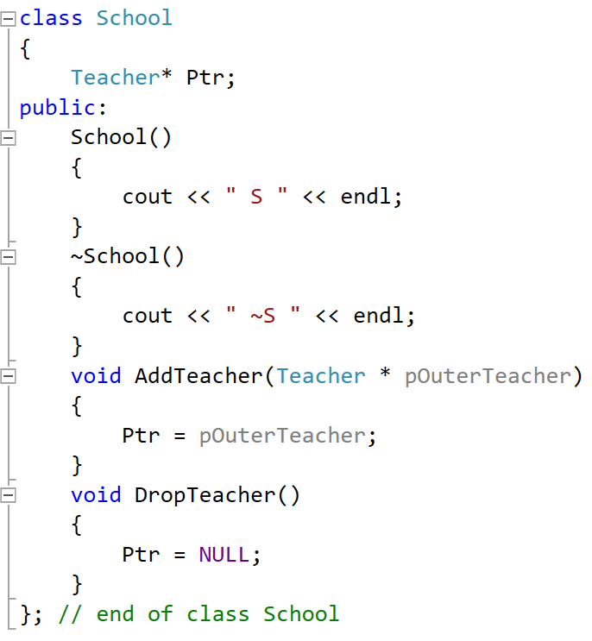
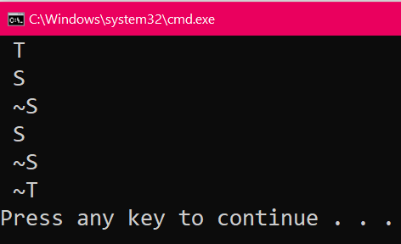
Association
S2
T Ptr
0
Ptr
School Objs
S1
Teacher Obj
2
2
T Ptr
T1
1
Ptr
id
3
Heap
Stack
1
Note:
Ptr is a Pointer, so to call a function on it: Arrow Operator
P1->func();
Note: No constructor/destructor are called for Pointer data members by default.
3

Slide 10
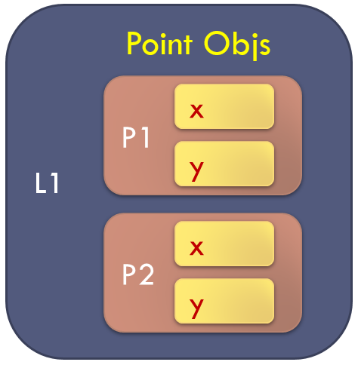
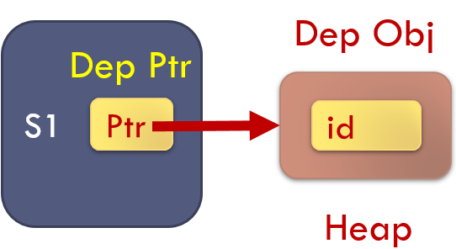
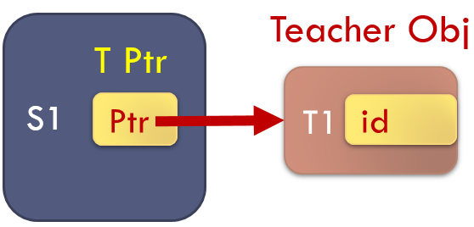
Composition
Aggregation
Association

Slide 11
Comparison
 | Composition | Aggregation | Association
Is the inner class object or pointer inside the outer? | Object To call: Obj.func() | Pointer To call: Ptr->func() | Pointer To call: Ptr->func()
The construction of the inner class object is the responsibility of: | The Outer Class (Automatic/Static Alloc.) | The Outer Class (Dynamic Alloc.) | NOT the Outer Class (e.g., in the main func. Or a third class)
The destruction of the inner class object is the responsibility of: | The Outer Class (Automatic/Static De-alloc.) | Maybe the Outer Class Based on user requirement (Dynamic De-alloc.) | NOT the Outer Class (e.g., in the main func. Or a third class)
Lifetime of the outer and inner class object: | Totally Dependent | Dependent in construction, and maybe also in destruction | Totally Independent
How strong is the relationship? | Very Strong | Strong | Weak

Slide 12
Non-Default Constructor in Composition

Slide 13
Array Variable
Class Relations

Slide 14
Review
Array of Objects
[0]
[1]
[2]
[3]
Arr[i] is an Object, so to call a function on it: Dot Operator
Arr[i].func();
Array of Integers
int Arr [4];
Array of Class Objects
Point Arr [4];
Array of Class Pointers
Point * Arr [4];
Arr[0] = new Point;
delete Arr[0];
delete Arr; // Wrong
Arr
x
x
x
x
y
y
y
y
Array of Pointers
Arr[i] is a Pointer, so to call a function on it: Arrow Operator
Arr[i]->func();
[0]
[1]
[2]
[3]
Arr
x
y

Slide 15
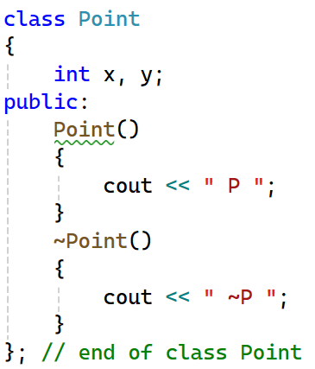
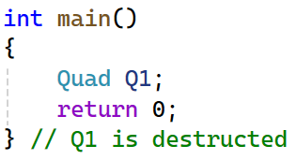
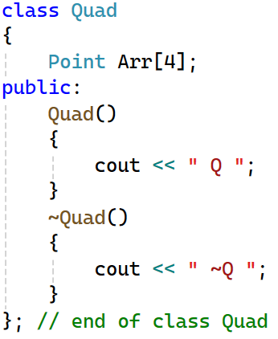
Composition
Q1
3
[0]
[1]
[2]
[3]
4 times
Arr
x
x
x
x
3
y
y
y
y
4 times
in reverse order
2
2
Note:
Arr[i] is an Object, so to call a function on it: Dot Operator
Arr[i].func();
1
4
1

Slide 16
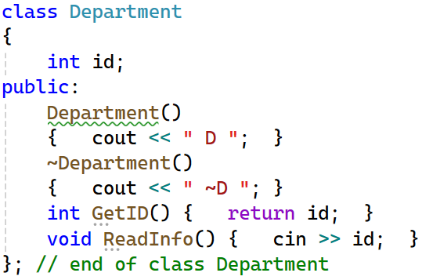
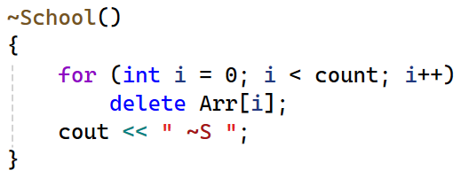
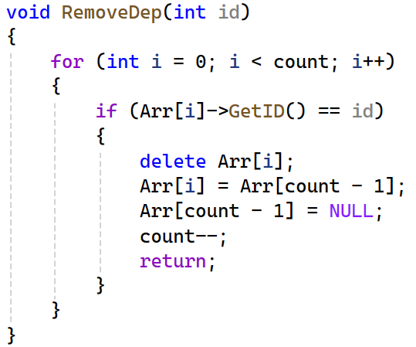
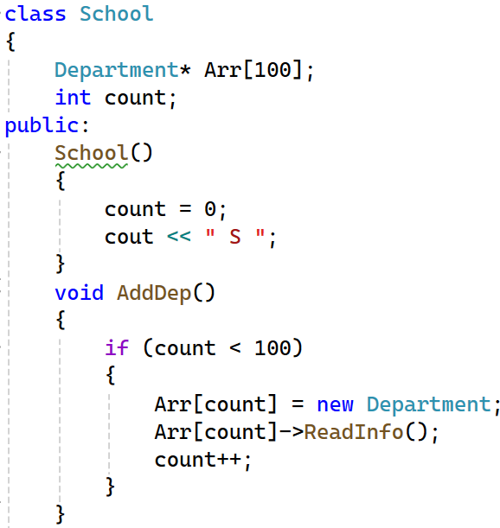
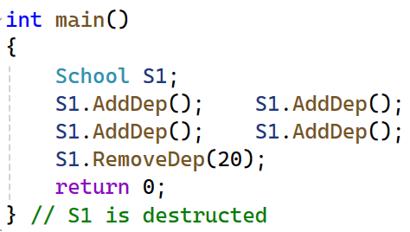

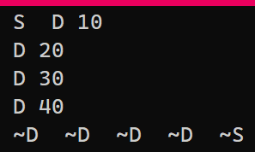
Aggregation
S1
count
4
[0]
[1]
[2]
[3]
[99]
2
1
D destructor is called “count” times
Arr
2
3
id
id
id
id
No D constructors are called
2
4
No more D destructors are called
1
3
Arr[i] is an Pointer, so to call a function on it: Arrow Operator
Arr[i]->func();
1

Slide 17
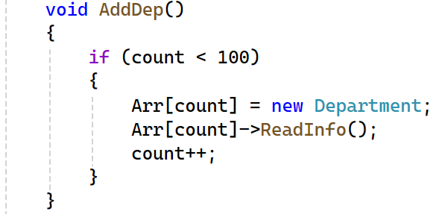

Aggregation: Add Department
count
3
[0]
[1]
[2]
[3]
[99]
Arr
Department constructor is called
10
20
30
1
count
4
2
3
[0]
[1]
[2]
[3]
[99]
Arr
In the main:
10
20
30
40

Slide 18
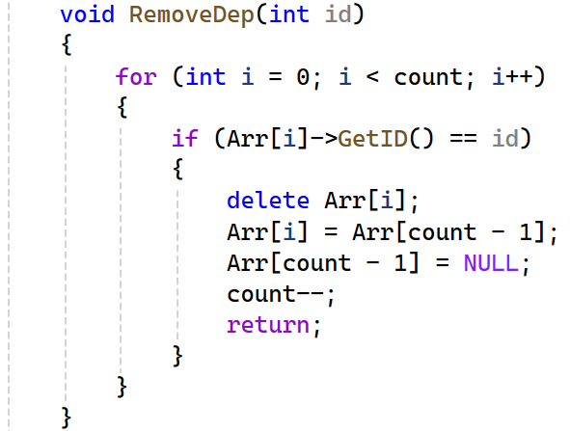

Aggregation: Remove Department
count
4
[0]
[1]
[2]
[3]
[99]
Arr
10
20
30
40
Department destructor is called
1
2
count
3
3
[0]
[1]
[2]
[3]
[99]
4
Arr
In the main:
10
30
20
40

Slide 19
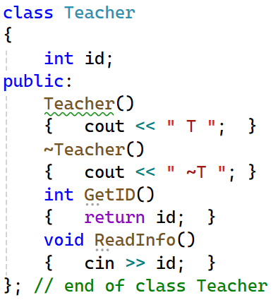
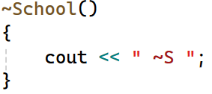
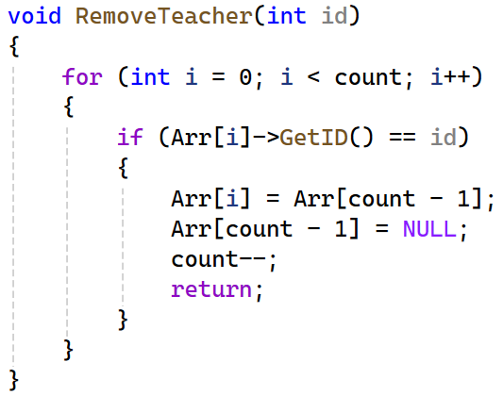
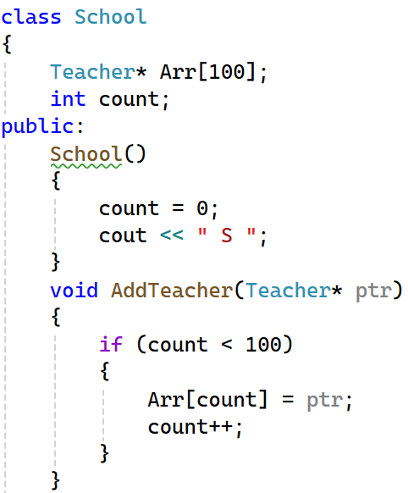
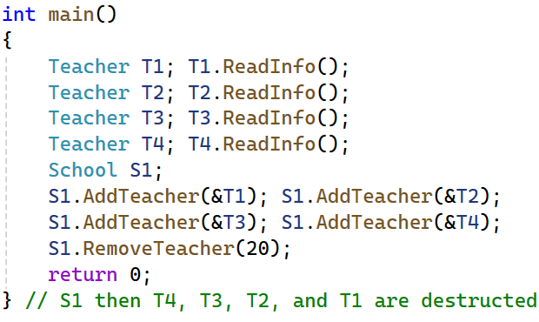
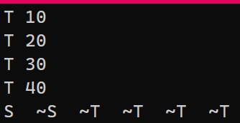

Association
S1
count
4
[0]
[1]
[2]
[3]
[99]
1
Arr
id
id
id
id
No T constructors are called
2
2
No T destructors are called
1
3
Arr[i] is an Pointer, so to call a function on it: Arrow Operator
Arr[i]->func();

Slide 20
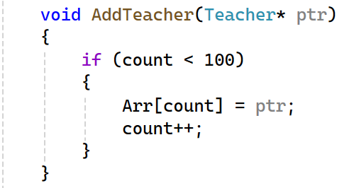

Association: Add Teacher
ptr
count
3
T4
40
[0]
[1]
[2]
[3]
[99]
Arr
10
20
30
Note: No Teacher constructors are called
count
4
1
2
[0]
[1]
[2]
[3]
[99]
Arr
In the main:
10
20
30
T4
40

Slide 21

Association: Remove Teacher
count
4
[0]
[1]
[2]
[3]
[99]
Arr
10
20
30
40
Note: No Teacher destructors are called
1
count
3
2
3
[0]
[1]
[2]
[3]
[99]
Arr
In the main:
10
30
Element 20 is Still Alive
But no referred to by the array
20
40

Slide 22
Comparison of implementation

Slide 23
Non-Default Constructor in Composition

Slide 24
Thank you

